Slide 1

ECB1223 – MICROCONTROLLERS AND INTERFACING MODULE 1 - SECURE CHIME USING ARDUINO
Presented by:
ABITHA K R (2303811710622003)
AKALYA B (2303811710622008)
GAYATHRI K K (2303811710622026)
Under the Guidance of
Mrs. SUDHA P
Assistant Professor
ECE

Slide 2
OUTLINE
ABSTRACT –MODULE 1
INTRODUCTION
CIRCUIT DIAGRAM
CIRCUIT DIAGRAM EXPLANATION
HARDWARE REQUIREMENT
ADVANTAGES AND APPLICATIONS
CONCLUSION

Slide 3
MODULE 1 – SECURE CHIME USING ARDUINO

Slide 4
ABSTRACT - MODULE 1
Secure Chime using Ardunio and IR Sensor is a cost-effective and efficient solution designed to enhance home security and automation.
Traditional doorbells lack intelligent features and often require manual operation.
This project aims to modernize the conventional doorbell system by integrating an Infrared (IR) sensor, Ardunio microcontroller, and optional output modules such as buzzers, LEDs, or wireless notifications.
The IR sensor detects motion or presence near the door without physical contact.
When a person approaches the entrance, the IR sensor triggers the Ardunio, which then activates the doorbell system.
This contactless interaction not only ensures convenience but also supports hygiene and safety, particularly in public or high-traffic areas.

Slide 5
INTRODUCTION – MODULE 1
To Smart alternative to traditional doorbells.
Uses IR sensor to detect human presence.
Ardunio controls the system operation.
Enables contactless activation of the doorbell.
Improves hygiene, security, and convenience.
Low-cost and easy to build.
Can be expanded with extra features like camera or wireless alerts.

Slide 6
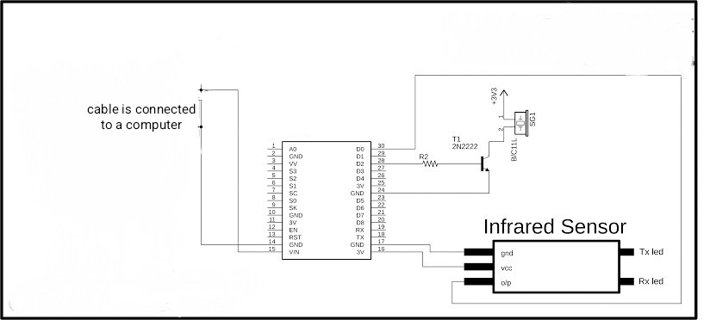
CIRCUIT DIAGRAM

Slide 7
CIRCUIT DIAGRAM EXPLANATION
The Arduino UNO acts as the main controller, processing input from the IR sensor and controlling the output devices.
A buzzer is used to produce a sound alert when a person is detected near the door.
An LED can also be added for visual indication when someone is present at the door.
A 220Ω resistor is connected in series with the LED to limit current and prevent damage.
The circuit uses the 5V supply from Arduino to power the IR sensor and output devices.
When no motion is detected, the IR sensor’s output remains LOW, and the Arduino takes no action.
The IR sensor continuously monitors the area in front of the door for movement.
This simple circuit provides automated alerting without any physical contact or manual pressing.

Slide 8
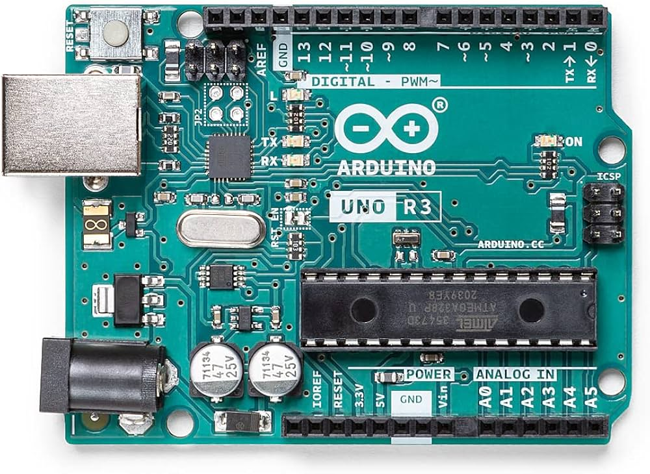
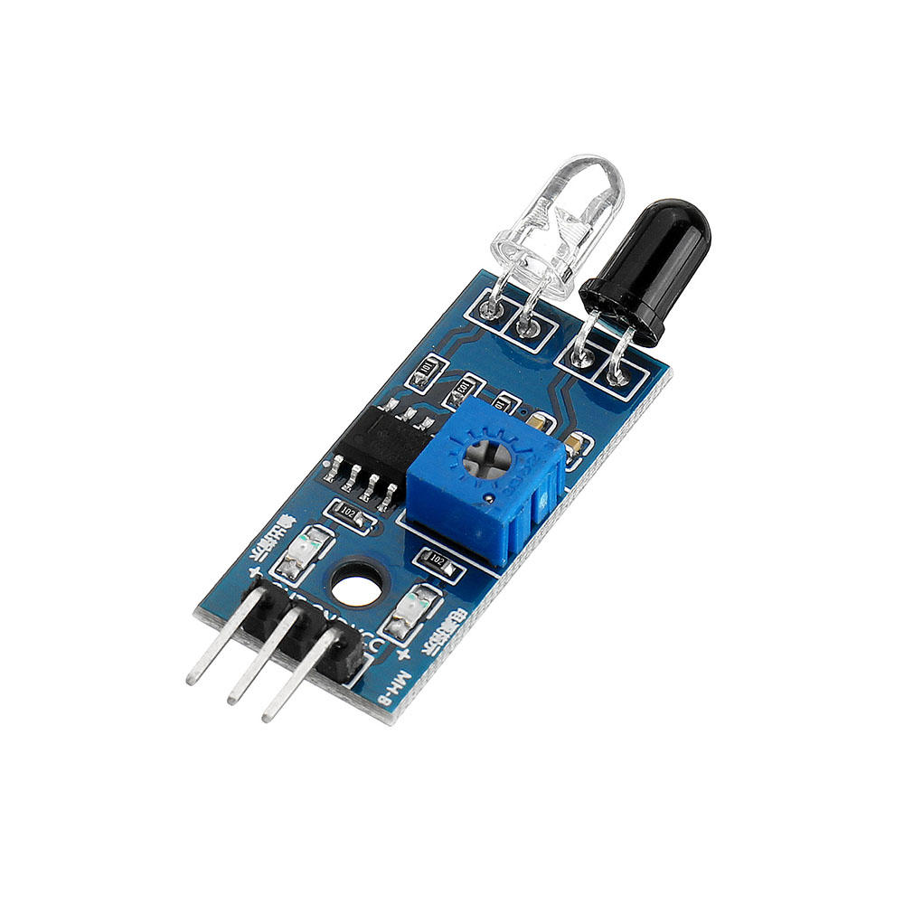
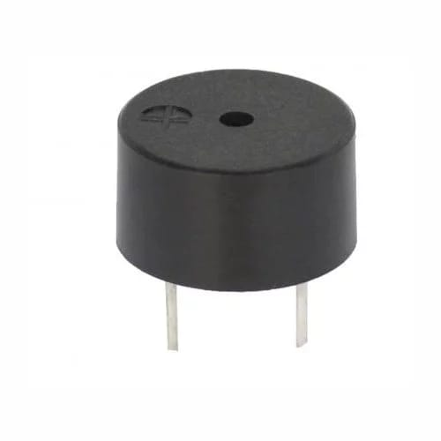
HARDWARE MODULE
IR Sensor (Infrared sensor),
Arduino UNO,
Jumper Wires,
Breadboard,
Buzzer,
USB Cable and laptop with arduino IDE.

Slide 9
ADVANTAGES AND APPLICATIONS
ADVANTAGES:
1. Contactless operation
2. Improved hygiene
3. Low cost
4. Easy installation
5. Energy efficient
APPLICATIONS:
1. Apartments
2. Offices
3. Shops
4. Hospitals and clinics
5. Smart home systems

Slide 10
CONCLUSION
The smart doorbell using Arduino and IR sensor offers a modern, touchless solution for visitor detection.
It enhances safety, hygiene, and convenience with a simple and cost-effective design.
The project serves as a foundation for further development into fully integrated smart home systems.

Slide 11
THANK YOU

